Slide 1


AI: Impact and Mitigation
Feb 14, 2022

Slide 2

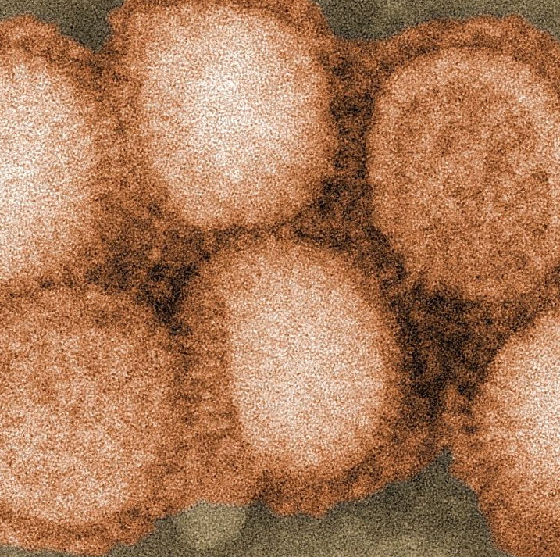





What is AI’s Impact on Food Producers?
  In domestic poultry, AI viruses are typically low pathogenicity (LP), causing subclinical infections, respiratory disease, or drops in egg production, but AI viruses can also be highly pathogenic (HP), causing severe systemic disease with multiple organ failure and high mortality.
  Low pathogenicity
  In layers and breeders, there may be decreased egg production or infertility. The morbidity and mortality are usually low unless accompanied by secondary bacterial or viral infections or aggravated by environmental stressors.
  High pathogenicity
  AI viruses of high pathogenicity however cause severe, systemic disease with high mortality in chickens, turkeys, and other poultry. Mortality can be as high as 100% in a few days.
  HPAI was responsible for the loss of nearly 50 million US chickens and turkeys in 2015, reducing the commercial (egg) layer populations by 10%¹. The most recent outbreak started in Feb 2022².
  1 Watt Agent
  2 https://www.aphis.usda.gov/aphis/newsroom/stakeholder-info/sa_by_date/sa-2022/hpai-indiana?gclid=Cj0KCQiAmKiQBhClARIsAKtSj-m82_CUGzgk0kKIwmQhETDJmQU8dR8mv3ahgjPPRl8XY1_D9s0r0rkaAgVFEALw_wcB

Slide 3









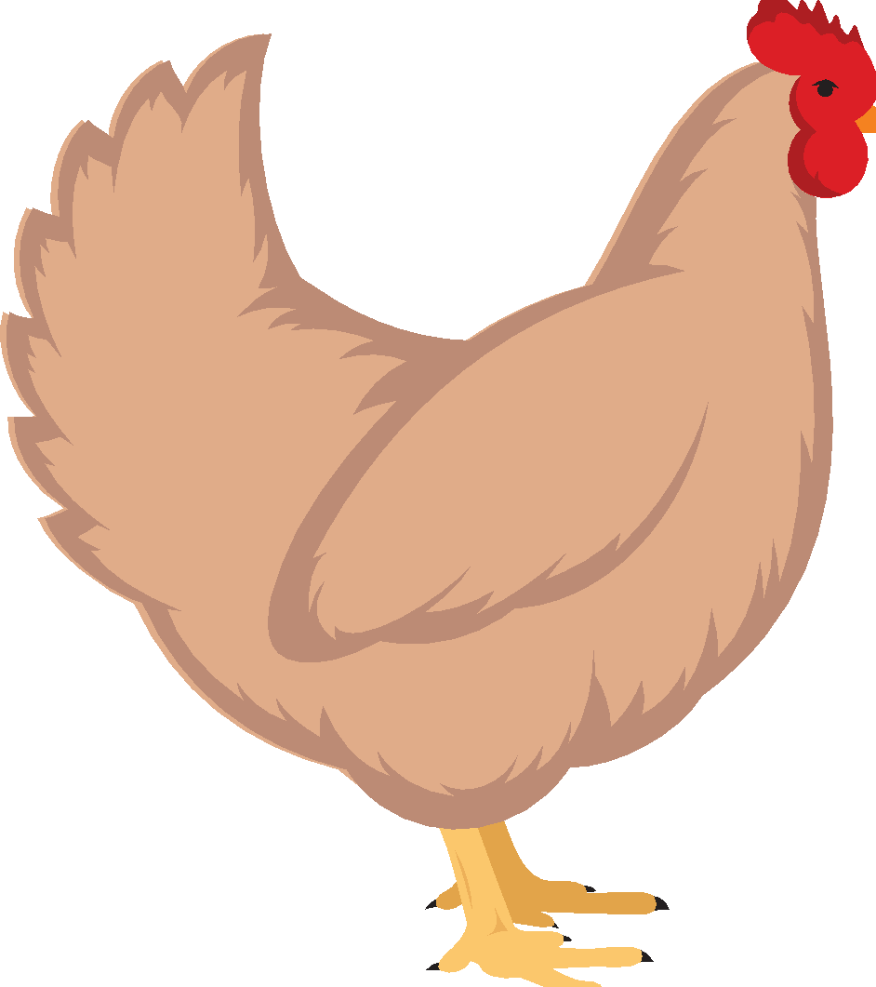
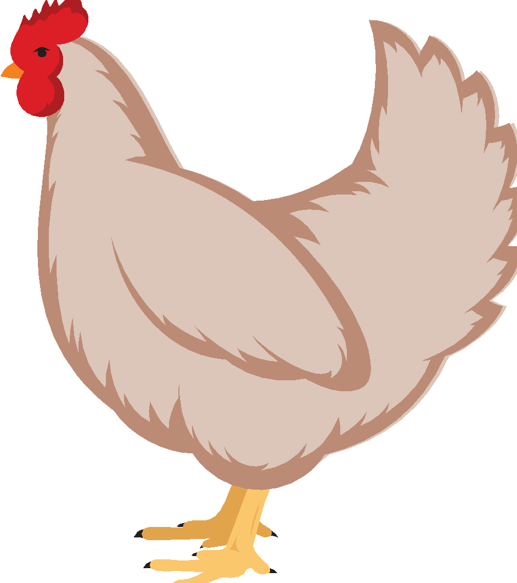


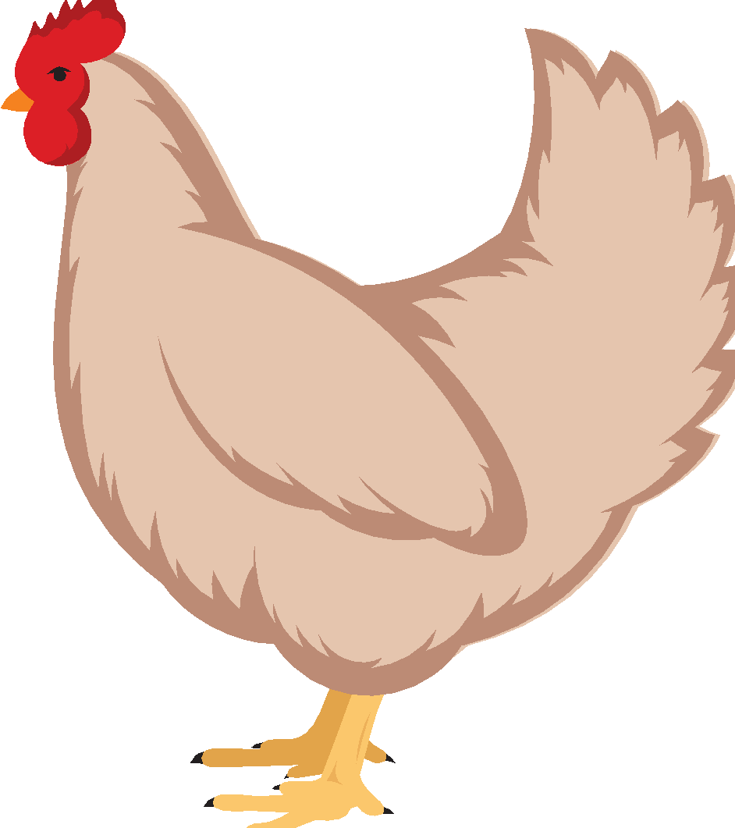
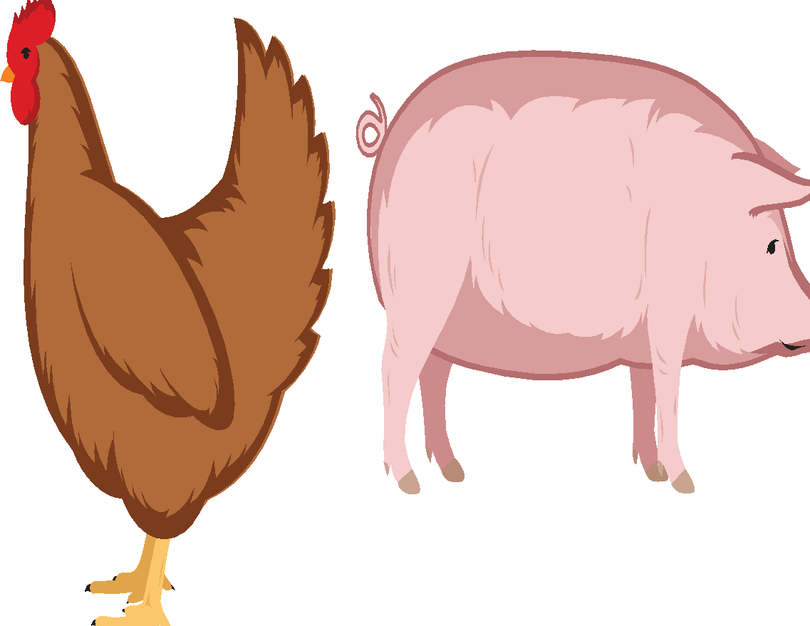
Could Controlling Avian Influenza (AI) Start with Animal Feed?
  Avian influenza is a viral infection found in domestic poultry and a wide range of other migratory birds.
  The primary risks for introduction into commercial poultry include:
  1
Direct or indirect contact
with infected wild birds
  2
Untreated contaminated surface water
  3
Location in the same geographic region as pigs infected with endemic swine influenza virus
  4
Epidemiologic links to a live poultry marketing system
(turkey breeder hens only)
Notes:
(Davies & Wray, 1996; Thakur & Grover, 2001; Desmarais et al., 2002).

Slide 4





How Can AI be Mitigated?
  The principal preventive strategy is avoidance of infection by minimizing the risk for AI virus introduction or exposure. Prevention is typically accomplished primarily by biosecurity.
Vaccination
Effectiveness:
AI vaccines provide protection from clinical signs and death, but protection is hemagglutinin subtype specific.
Countries that vaccinate are considered positive to AI.
Eradication (stamping out of AI-positive flock) followed by quarantine and negative test results will restore AI-free status.
Note: Vaccination for AI can lead to trade restrictions, which is why it is not common.
Heat treatment of feed
Effectiveness:
AIV, which is susceptible to heat, is typically killed during the pelleting process (though not all feeds are pelleted). Also, heat treatment does not provide any residual protection against recontamination.¹
Feed Sanitizers
Effectiveness:
Treatment of feed with Termin-8 at 1 kg/ton significantly reduced (P<0.05) AIV RNA in samples obtained after 1 hr after contamination.
Dosage: 1 and 3 kg/ton work equally well.
Suspending the virus in an organic matrix (skimmed milk) increased AIV survivability in feed, but did not impact the effect of Termin-8.
¹ USDA: Risk that Poultry Feed made with Corn— Potentially Contaminated with EurasianNorth American Lineage H5N2 HPAI Virus from Wild Migratory Birds—Results in Exposure of Susceptible Commercial Poultry

Slide 5
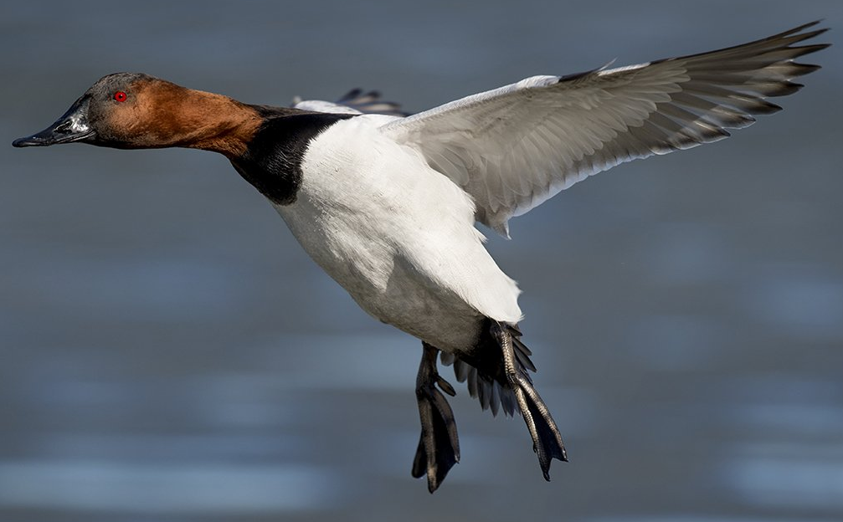
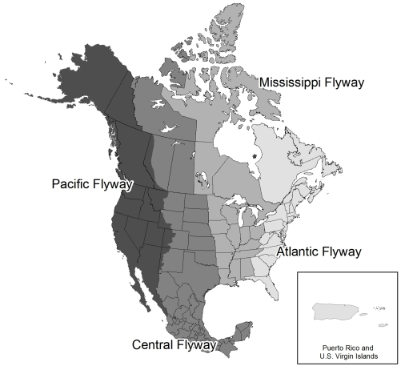
Feed Sanitation Offers Additional Biosecurity in the Face of HPAI
  The usual reservoir for HPAI are migratory waterfowl that land in North America through the three main flyways and mingle with local birds that in turn may have access to raw materials and poultry feeds establishing a contamination chain to commercial poultry. Turkeys are more susceptible than chickens to Waterfowl-origin Avian Influenza viruses¹.
  Feed treatment using Termin-8 has been shown to mitigate the risk of transmission through feed matrices².
US Fish and Wildlife Service
  ¹ Avian Dis, 54(s1), 522-526.
  ²Avian Dis.; 60(4):846-849

